Slide 1
Onboarding Toolkit
Section 1 Template #4

Slide 2
We will run you through a number of examples
Every “life scenario” can be explained through these two main functional scenarios.
 | Request & Issuance of VC | Presentation & verification of VC
Story 01 - Claim a bachelor’s degree
Story 02 - Apply for a Master Degree
Story 03 - Claim access to public services using StudentID
Story 04 - Apply for an Erasmus Programme
Story 05 - Claim a Master Degree
Story 06 - Claim a License to Practice
Story 07 - Apply for a PhD
Story 08 - Apply for a short course / training
Story 09 - Claim training course certificate
Story 10 - Apply for a job

Slide 3
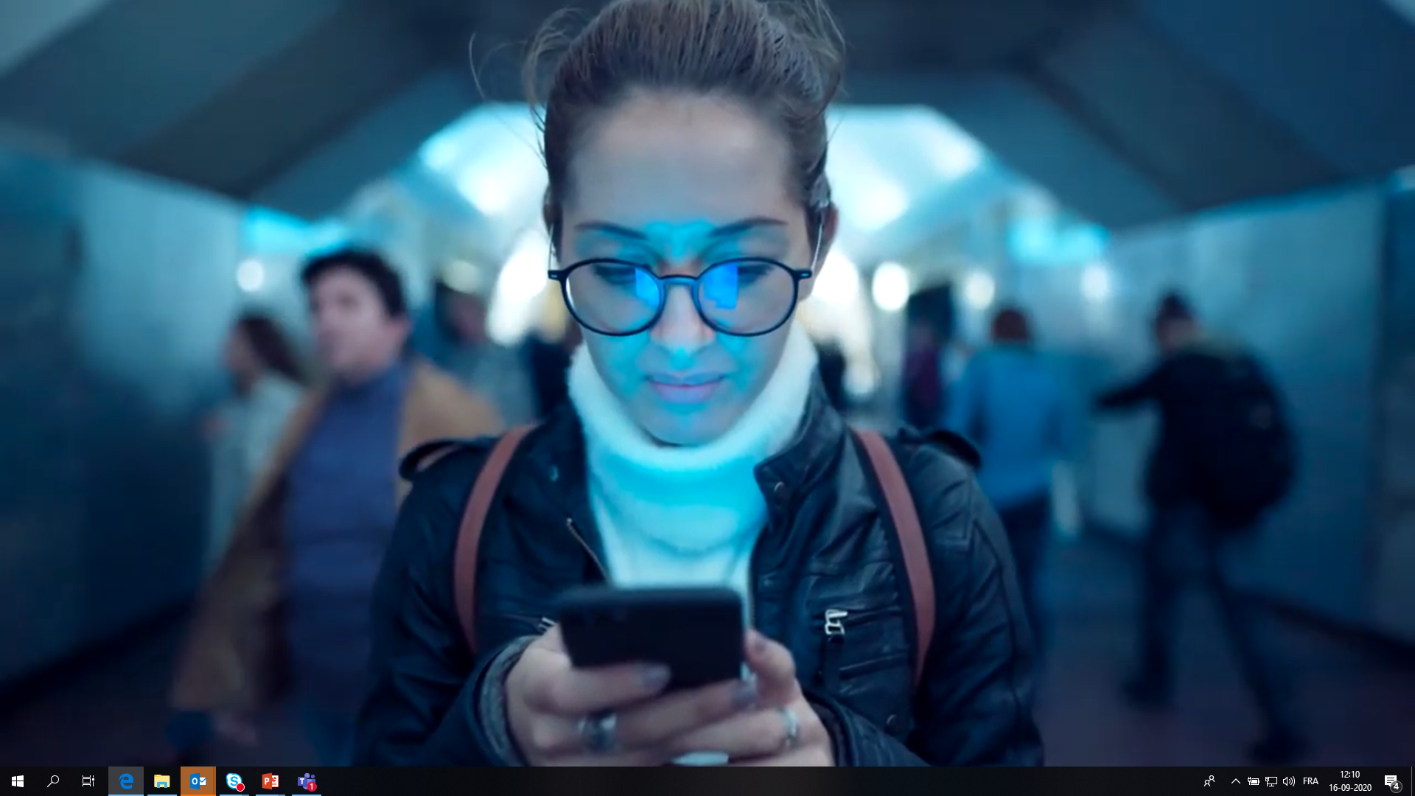
Let’s imagine the following scenario. Imagine you are a Belgian student.

Slide 4

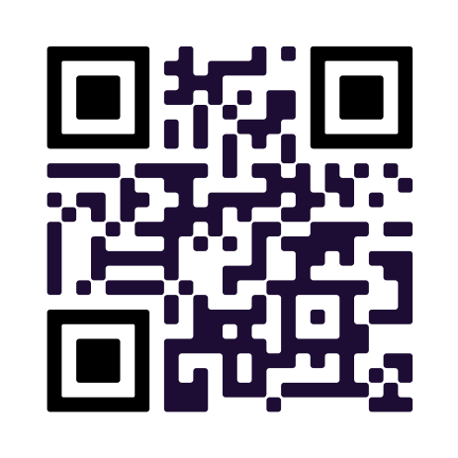
You just graduated with a Bachelor's degree at a Belgian university. You have your whole life ahead of you and so many options. Before going any further, you know that you need to request and download your diploma so that you can easily apply to universities or jobs in the future.
Scan here

Slide 5
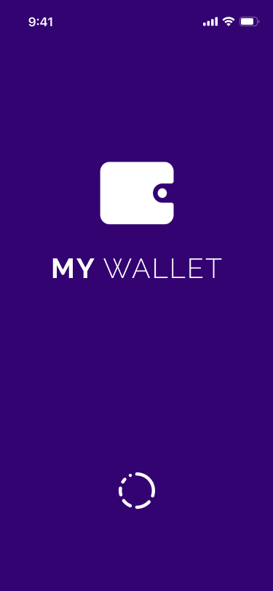
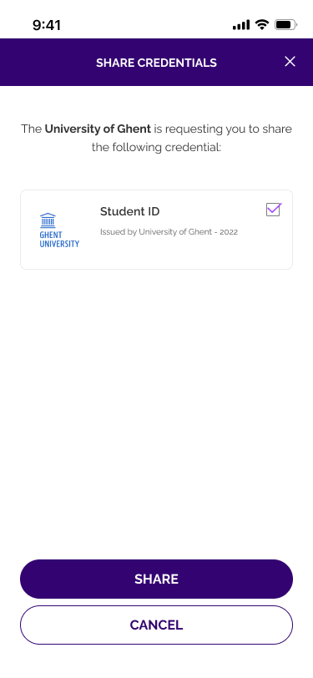
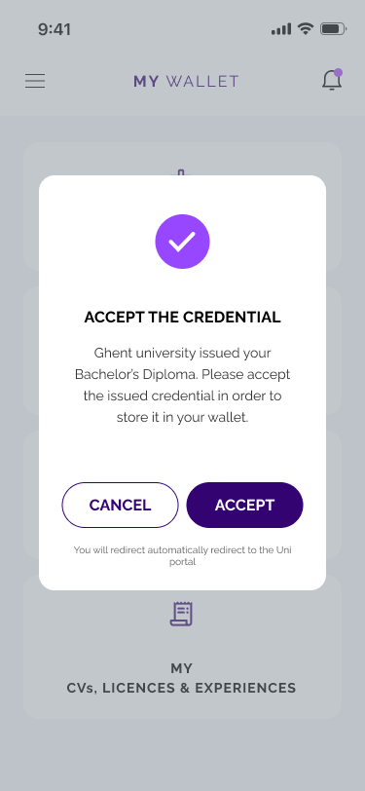
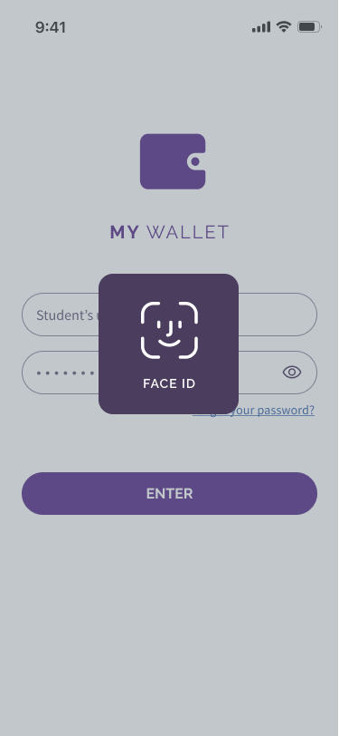
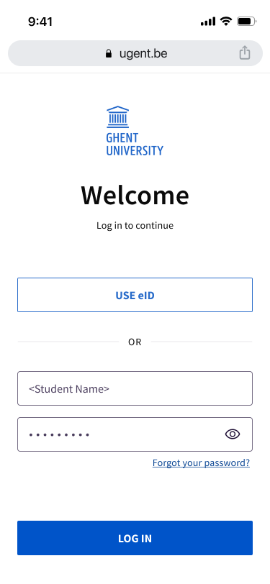
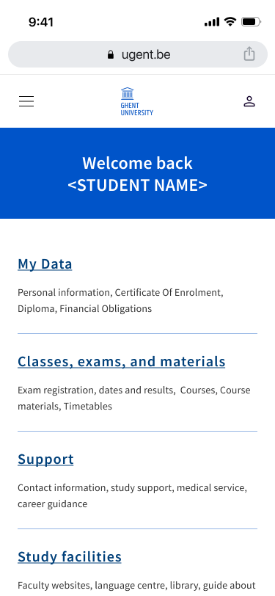
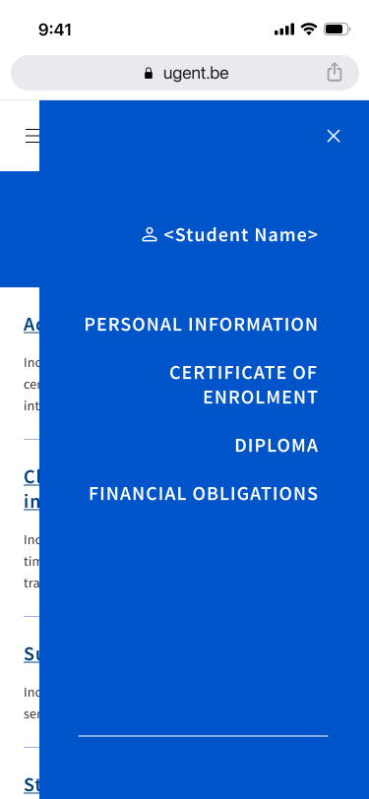
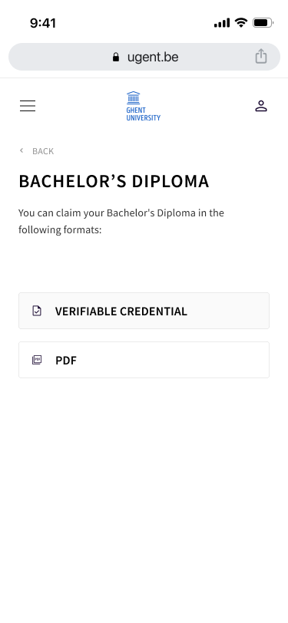
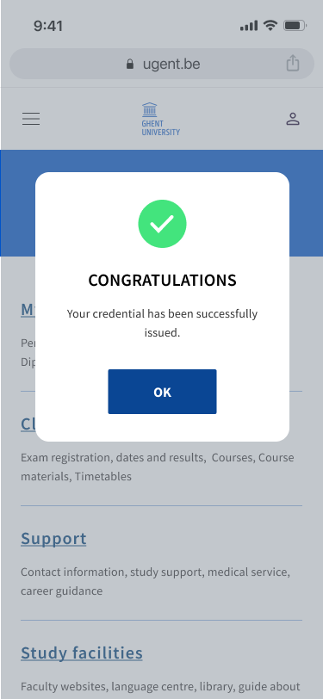
Story 01 – Claim a bachelor’s degree
Request and issuance of Verifiable Credential
To claim the VC with my wallet, as the <student>, I’m redirected to my digital wallet that I unlock
To proceed with the VC issuance, as a <student>, I authorize (in my wallet) to share <verifiable credential> with the <education institution> that is required for the VC issuance (e.g. student ID).
To claim my <verifiable credential>, as a <student>, I am notified that my <verifiable credential> has been issued and I confirm/deny claiming the VC.
To consume a service, as <student>, I visit the <education institution> website where I log in
To start with the VC issuance process, as a <student>, I navigate through the website and select the issuance of my <verifiable credential>, e.g. Bachelor Degree.
To claim the <verifiable credential> in a given format, as a <student>, I select the <verifiable credential> issuance in the Verifiable Credential format.
To continue with my actions, as a <student>, I’m redirected to the website of the <educational institution> and I receive confirmation that the <verifiable credential> has been successfully issued and claimed
*The <education institution> receives the requested <verifiable credential>, which is automatically verified by the system, and proceeds with the issuance of the <verifiable credential>

Slide 6
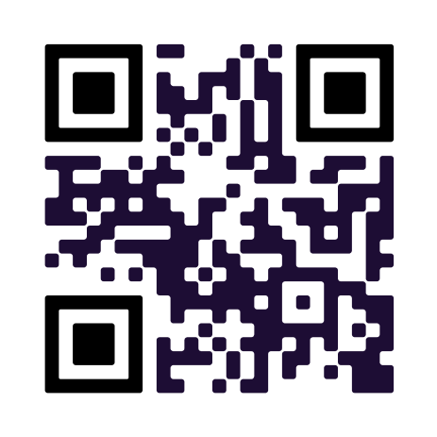
After some reflection, you have decided to apply for a master's degree programme in another University in Belgium.
Scan here

Slide 7
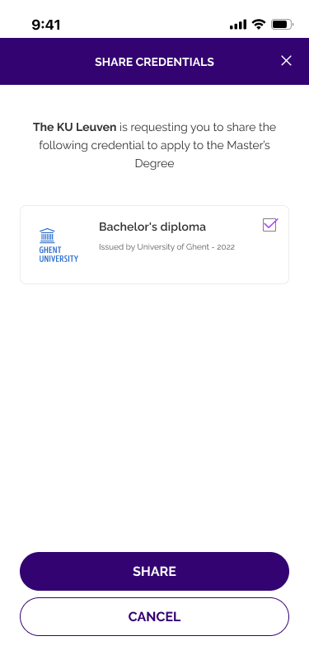
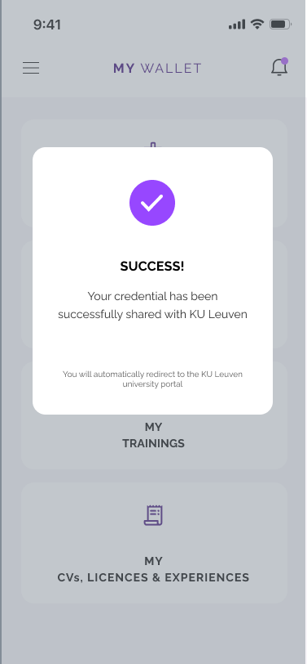
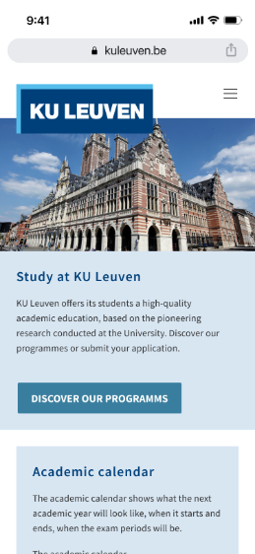
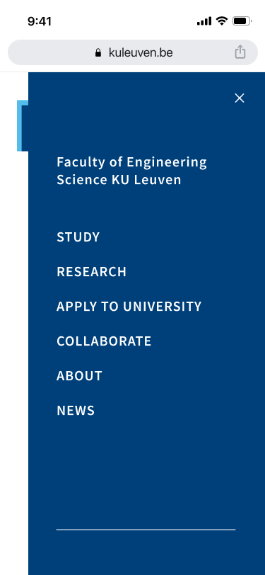
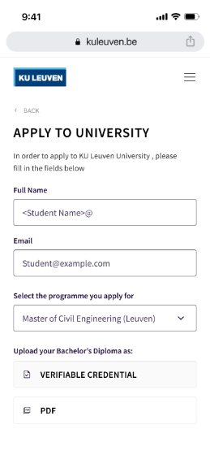
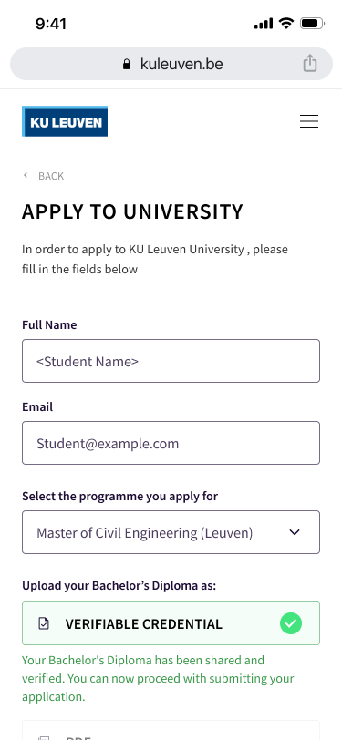
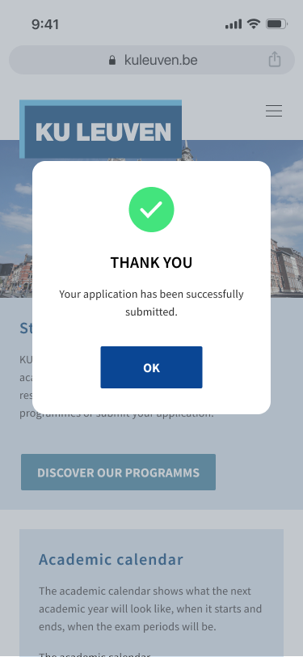
Story 02 – Apply for a Master Degree
Presentation and verification of Verifiable Credential
To share my VCs with my wallet, as a <student>, I’m redirected to my wallet that I unlock.
To send my VCs to the <education institution>, as a <student>, I select the VCs I want to share and I authorize the sharing.
The <student> is notified by the wallet that the <verifiable credential> has been shared successfully.
To apply to a given study, as a <student>, I visit the university website and find the application process
I start the application process by filling-in the input form. In this input form, I’m invited to upload and share specific document(s) e.g. Bachelor Diploma.
To submit the application form, as a student, I’m redirected to the organisation website and I’m invited to finalise my application process and submit it to the <education institution>
After clicking on ‘submit’, as a <student>, I’m notified that my application has been successfully submitted.
To upload / share the document in a given format, as a <student>, I select share <verifiable credential> in the Verifiable Credential format.
*The <education institution> receives the <verifiable credential(s)>, which is/are automatically verified by the system, and proceeds with the enrolment process

Slide 8
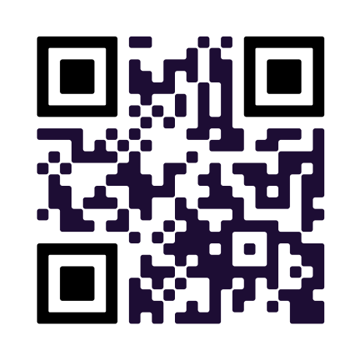
Congratulations! Your enrolment has been confirmed! You're starting your year, making new friends and connections and working hard to keep up with your studies and get good grades. After one year, you decide to take a break and go to Spain. As a student, you can have access to some discounts for visiting museums.
Scan here

Slide 9
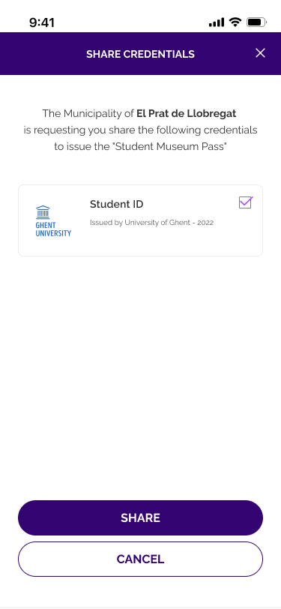
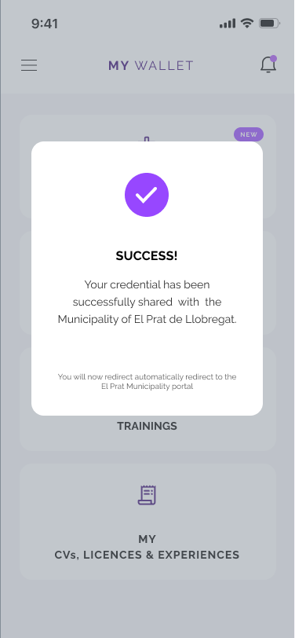
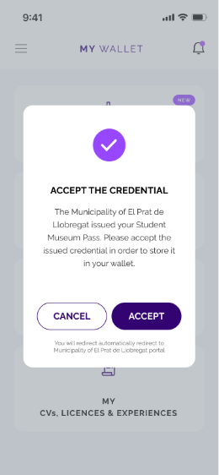
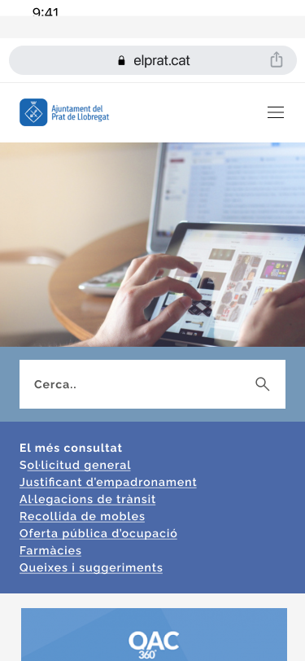
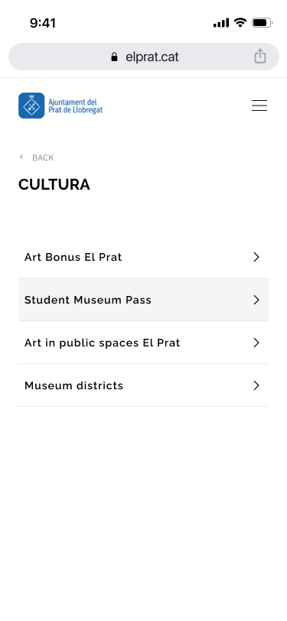
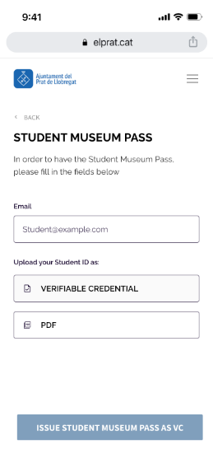
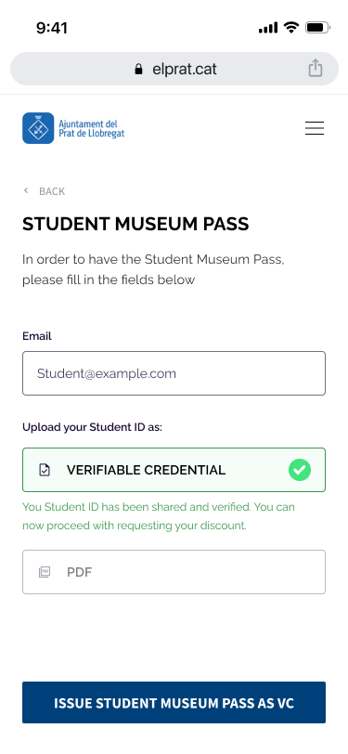
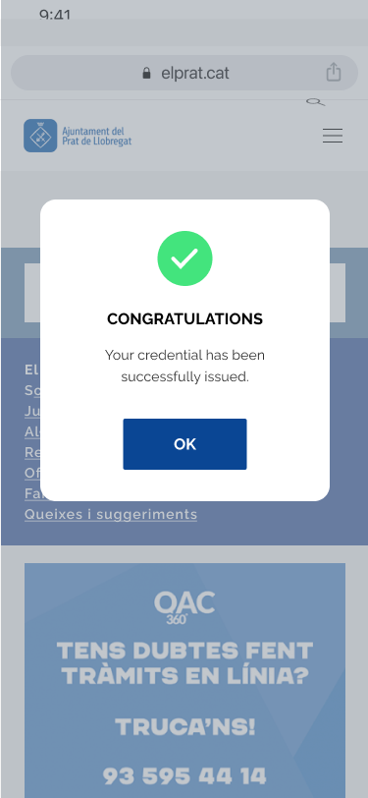
Story 03 – Claim access to public services using StudentID
Presentation & verification of VC / Request & Issuance of VC
To share my <verifiable-credentials> with my wallet, as a <student>, I’m redirected to my wallet that I unlock.
To share my VCs with the <institution>, as a <student>, I select the VCs I want to share and I authorize the sharing.
The <student> is notified by the wallet that the <verifiable credential> has been successfully shared.
To claim the VC with my wallet, as the <student>, I’m redirected to my digital wallet that I unlock
To claim my <verifiable credential>, as a <student>, I am notified that my <verifiable credential> has been issued and I confirm/deny claiming the VC.
To obtain a student discount card, as a <student>, I visit the <institution> website and find the application form
I start the process by filling-in the input form. In this input form, I’m invited to upload and share my <verifiable credential(s)>, i.e., Verifiable Student ID
To share the document(s) as Verifiable Credential(s), as a <student>, I select share <verifiable credential(s)> in the Verifiable Credential format.
To continue with the process, as a <student>, I’m redirected to the <institution> website where I’m invited to claim my student discount card
To continue with my actions, as a <student>, I’m redirected to the website of the <institution> and I receive confirmation that the <verifiable credential> has been successfully issued and claimed
*The <institution> receives the <verifiable credential(s)>, which is/are automatically verified by the system, and proceeds with the enrolment process (NO SCREEN)

Slide 10
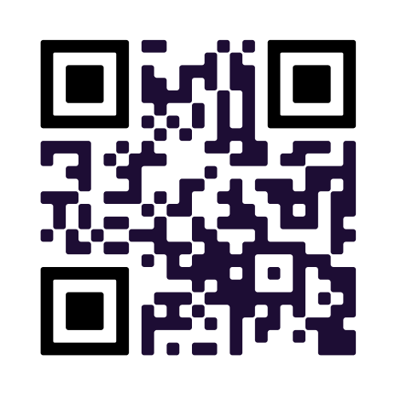
After spending several lovely days visiting museums around Spain with your student discounts, your holiday comes to an end. It's time to get back to Belgium! You decide to take your chance and start the process to go on Erasmus
Scan here

Slide 11

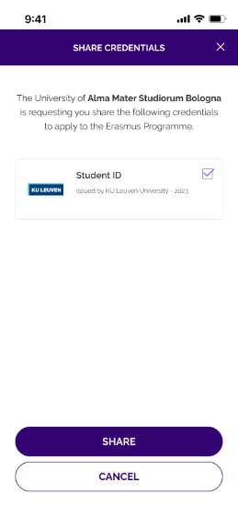
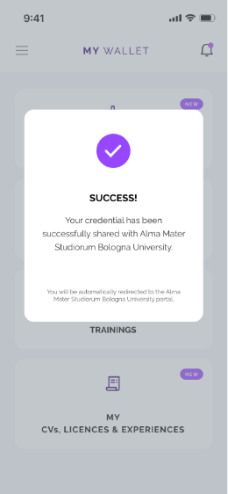
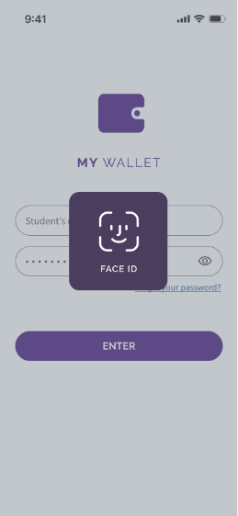
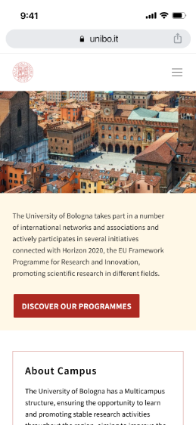
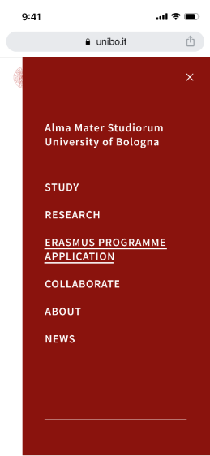
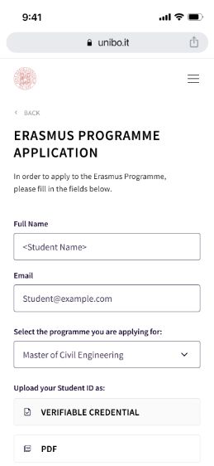
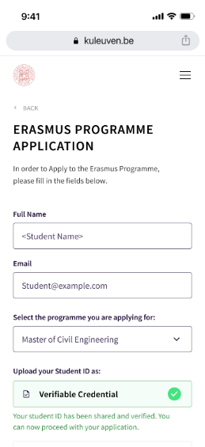
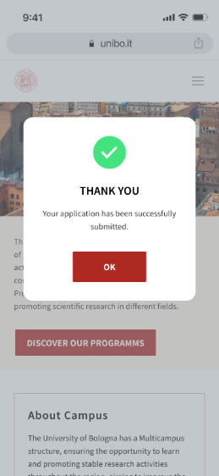
Story 04 - Apply for an Erasmus Programme
Presentation & verification of VC
To share my VCs with my wallet, as a <student>, I’m redirected to my wallet that I unlock.
To send my VCs to the <education institution>, as a <student>, I select the VCs I want to share and I authorize the sharing.
The <student> is notified by the wallet that the <verifiable credential> has been shared successfully.
To apply to a given study, as a <student>, I visit the university website and find the application process
I start the application process by filling-in the input form. In this input form, I’m invited to upload and share specific document(s) e.g. StudentID.
To submit the application form, as a student, I’m redirected to the organisation website and I’m invited to finalise my application process and submit it to the <education institution>
After clicking on ‘submit’, as a <student>, I’m notified that my application has been successfully submitted.
To upload / share the document in a given format, as a <student>, I select share <verifiable credential> in the Verifiable Credential format.
*The <education institution> receives the <verifiable credential(s)>, which is/are automatically verified by the system, and proceeds with the enrolment process

Slide 12
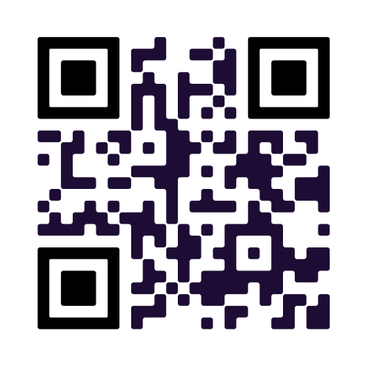
Congratulations! Your request has been approved and you can go to Bologna. After staying there for 6 months, you head back to Belgium. Your transcript of records has been issued and you have succeeded with final exams. You can now request your Master’s diploma so that you can easily apply for jobs or other university programmes in the future.
Scan here

Slide 13

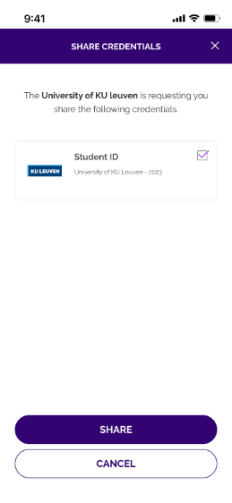
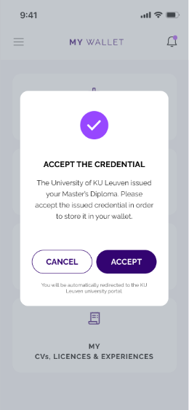
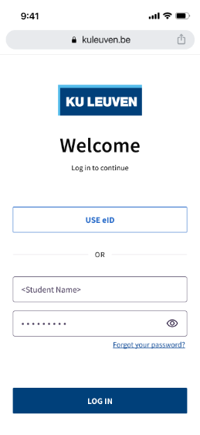
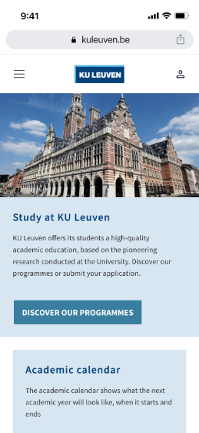
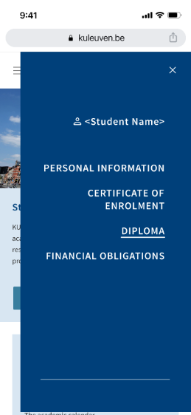
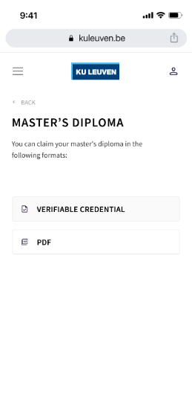
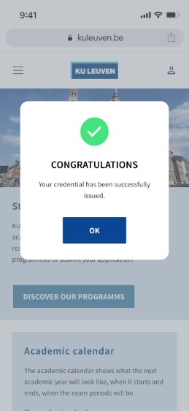
Story 05 - Claim a Master Degree
Request & Issuance of VC
To claim my <verifiable-credentials> in my wallet, as a <student>, I’m redirected to my wallet that I unlock.
To share my VCs with the <institution>, as a <student>, I select the VCs I want to share and I authorize the sharing.
To claim my <verifiable credential>, as a <student>, I am notified that my <verifiable credential> has been issued and I confirm/deny claiming the VC.
To claim a degree, as a <student>, I log into the university website
I start the process by navigating to the Diploma page on the university website
To claim a degree as Verifiable Credential(s), as a <student>, I select claim <verifiable credential(s)> in the Verifiable Credential format.
To continue with my actions, as a <student>, I’m redirected to the website of the <institution> and I receive confirmation that the <verifiable credential> has been successfully issued and claimed
*The <institution> receives the <verifiable credential(s)>, which is/are automatically verified by the system, and proceeds with the issuing process

Slide 14
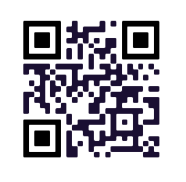
It’s time to move on from student life and begin your career journey. You are feeling adventurous and are itching to go abroad and enjoy some new cultural experiences.
How might you do that? Work abroad! You love Greece and wish to start your career there. To be able to work, you need a Licence to Practice issued by an accredited Chamber from that country.
Scan here

Slide 15
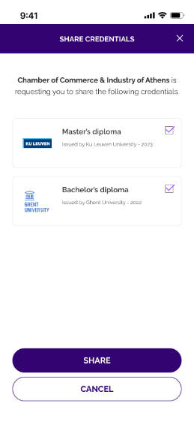
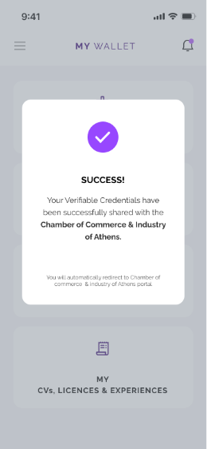
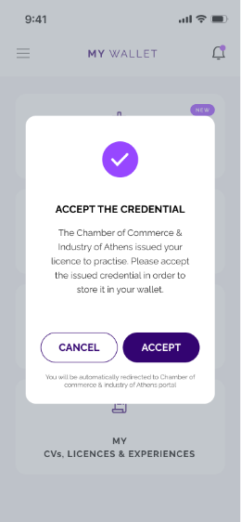
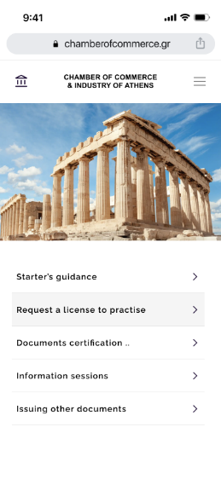



Story 06 - Claim a License to Practice
Request & Issuance of VC
To share my <verifiable-credentials> with my wallet, as a <student>, I’m redirected to my wallet that I unlock.
To share my VCs with the <institution>, as a <student>, I select the VCs I want to share and I authorise the sharing.
The <student> is notified by the wallet that the <verifiable credential> has been successfully shared.
To claim the VC with my wallet, as the <student>, I’m redirected to my digital wallet that I unlock
To claim my <verifiable credential>, as a <student>, I am notified that my <verifiable credential> has been issued and I confirm/deny claiming the VC.
To obtain a student discount card, as a <student>, I visit the <institution> website and find the application form
I start the process by filling-in the input form. In this input form, I’m invited to upload and share my <verifiable credential(s)>, i.e., My diplomas
To continue with the process, as a <student>, I’m redirected to the <institution> website where I’m invited to claim my student discount card
To continue with my actions, as a <student>, I’m redirected to the website of the <institution> and I receive confirmation that the <verifiable credential> has been successfully issued and claimed
To share the document(s) as Verifiable Credential(s), as a <student>, I select share <verifiable credential(s)> in the Verifiable Credential format.
*The <institution> receives the <verifiable credential(s)>, which is/are automatically verified by the system, and proceeds with the enrolment process (NO SCREEN)

Slide 16

After some working experience, you decide to go back to Belgium. You wish to challenge yourself and you want to expand your expertise and knowledge. You decide to apply for a PhD.
Scan here

Slide 17







Story 07 - Apply for a PhD
Presentation & verification of VC
To apply to a given study, as a <student>, I visit the university website and find the application process
I start the application process by filling-in the input form. In this input form, I’m invited to upload and share specific document(s) e.g. My Diplomas
To share my VCs with my wallet, as a <student>, I’m redirected to my wallet that I unlock.
To send my VCs to the <education institution>, as a <student>, I select the VCs I want to share and I authorize the sharing.
The <student> is notified by the wallet that the <verifiable credential> has been shared successfully.
To submit the application form, as a student, I’m redirected to the organisation website and I’m invited to finalise my application process and submit it to the <education institution>
After clicking on ‘submit’, as a <student>, I’m notified that my application has been successfully submitted.
To upload / share the document in a given format, as a <student>, I select share <verifiable credential> in the Verifiable Credential format.
*The <education institution> receives the <verifiable credential(s)>, which is/are automatically verified by the system, and proceeds with the enrolment process (NO SCREEN)

Slide 18

A few months into your PhD programme, you hear about a course at a foreign university that you think could be extremely valuable for your PhD research. You find out it's possible to apply and go abroad for the course.
Scan here

Slide 19







Story 08 - Apply for a short course / training
Presentation & verification of VC
To share my VCs with my wallet, as a <student>, I’m redirected to my wallet that I unlock.
To send my VCs to the <education institution>, as a <student>, I select the VCs I want to share and I authorize the sharing.
The <student> is notified by the wallet that the <verifiable credential> has been shared successfully.
To apply to a given course/training, as a <student>, I visit the university website and find the application process
I start the application process by filling-in the input form. In this input form, I’m invited to upload and share specific document(s) e.g. Student ID
To upload / share the document in a given format, as a <student>, I select share <verifiable credential> in the Verifiable Credential format.
To submit the application form, as a student, I’m redirected to the organisation website and I’m invited to finalise my application process and submit it to the <education institution>
After clicking on ‘submit’, as a <student>, I’m notified that my application has been successfully submitted.
*The <education institution> receives the <verifiable credential(s)>, which is/are automatically verified by the system, and proceeds with the enrolment process (NO SCREEN)

Slide 20

Congratulations! Your request has been approved. After a few months, you pass the course with flying colours, gaining valuable skills and knowledge. You can now request your certificate.
Scan here

